Slide 1
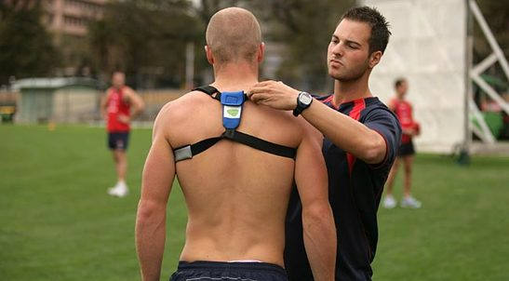
Data Analytics and Data Mining Project (Group 6)
Interrelationship between sensor data series using GAA data
Haree Varshan Jeyaram - 17211965
Mithra Devi Veeramohan - 17210404
Sai Shree Malepati Ravikumar - 17210622
Viswanathan Umamaheswaran - 17211729

Slide 2
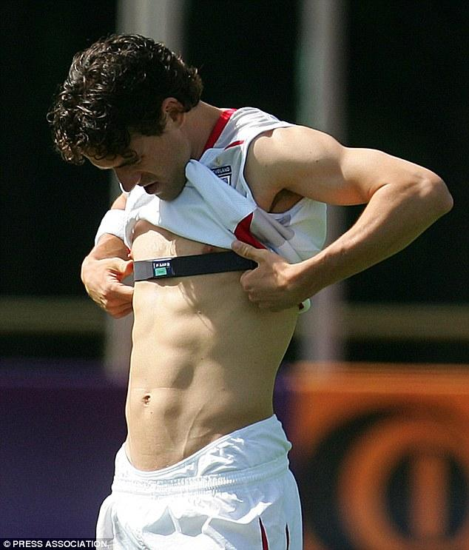
Research Question ?
Predicting what variables determine the Rate of Perceived Exertion (RPE)
Based on the key attributes like session, duration, load, RTT, distance, speed, heart rate, sprints etc.

Slide 3
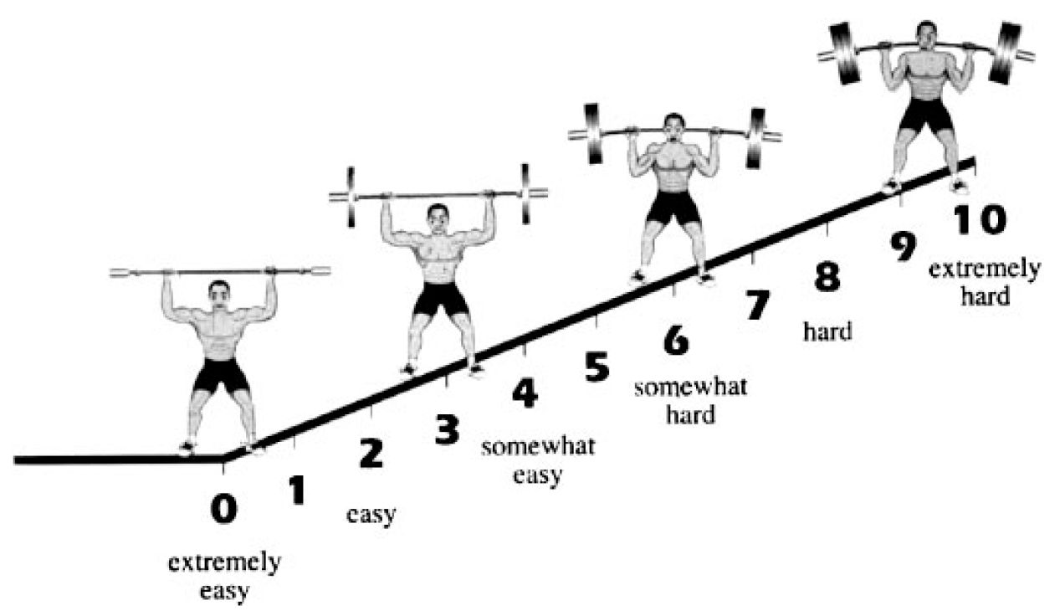
Phase 1 - Business Understanding
What is RPE ?
Measure intensity of a physical activity
Ranges from 0 – 10
Monitors stress and progress of physical strength
Modifies training process before the outcome, thus optimizing soccer performance

Slide 4
Phase 2 - Data Understanding
Data source: GAA (Gaelic Athletic Association)
Data set consists of the following tables:
RTT & RPE Project Database.xlsx → Training_Database – RPE, RTT, Load etc.
derivedkpi.csv – distance, speed, bodyload etc.
players.csv – 64 players
sessions.csv – 319 sessions
database_name.csv – player details

Slide 5
Phase 3 - Data Preparation
Data Construction and Integration
training_database.csv join database_names.csv on “username” ➔ Training_db_with_PlayerId
Training_db_with_PlayerId join sessions.csv on “date” ➔ Training_db_with_PlayerId_Sessions
Training_db_with_PlayerId_Sessions join derivedkpi.csv on “player_id” and “session_id” ➔ Final_Training_db.csv
Data Format
Converted percentage values RTT, RTT-1, RTT+1 to float values

Slide 6
Phase 3 - Data Preparation
Data Cleaning
Missing values :RPE - 142, RTT – 3736, RTT_Min_1 – 3228, RTT_Plus_1 - 3569 and Load
Present as 5000
Imputed based on mean value of variables for each player (key: Player_id)
Removed null value columns (112)
Label encoding & one hot encoding - computing categorical variable session_type

Slide 7
Phase 4 - Modeling
Model Selection
Identified as Regression problem
Linear Regression implemented between RPE and all other independent variables (121 variables)
Generate Test Design
Performed Backward Elimination for goodness-of-fit
Backward Elimination using p-value* 62 variables
*(a probability value used for statistical significance)

Slide 8
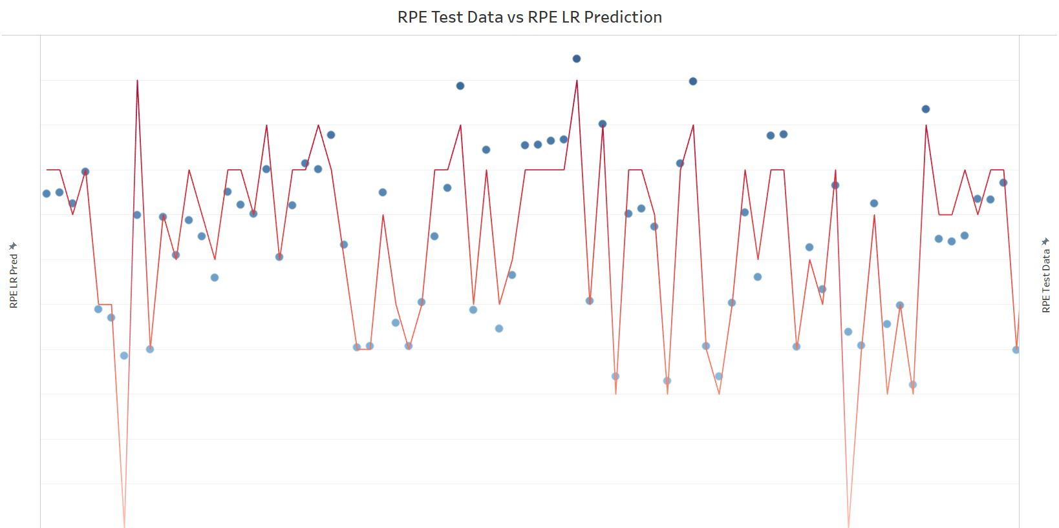
Phase 4 - Modeling
Assess Model
 | All variables | P-value(62 variables)
R Squared | 0.83 | 1
Actual Test Data of RPE values
Predicted RPE values

Slide 9
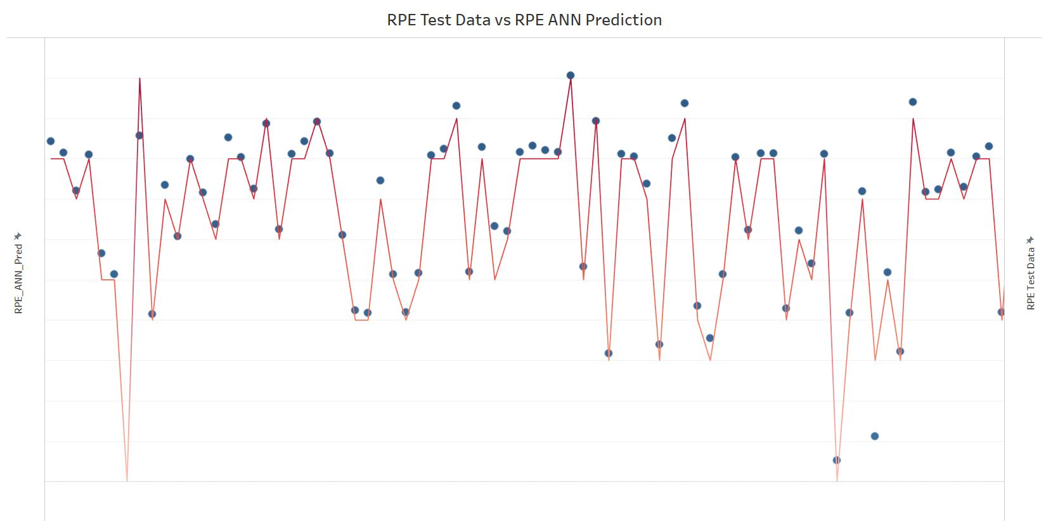
Phase 4 - Modeling
Artificial Neural Network (ANN)
To predict values of RPE using computational neurons
62 significant variables used
Three layers : Input, Hidden, Output
Actual Test Data of RPE values
Predicted RPE values

Slide 10
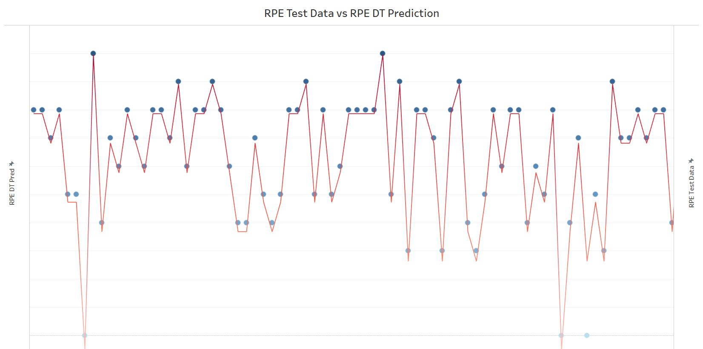
Phase 4 - Modeling
Decision Tree Regression
To predict value of RPE using decision rules
62 significant variables used
Actual Test Data of RPE values
Predicted RPE values

Slide 11
Phase 5 - Evaluation
Model comparison table
 | Linear Regression | Artificial Neural Network | Decision Tree Regression
Mean Squared Error | 0.67 | 0.34 | 0.04
Explained Variance Score | 0.84 | 0.92 | 0.99
Median Absolute Error | 0.32 | 0.14 | 0.0
MSE - measures the average of the squares of the errors.
EVS - measures the proportion to which a model accounts for the variation of a given data set.
MAE - measure of difference between two continuous variables.

Slide 12
Conclusion
Challenges
Plotting & Visualizing numerous independent variables
Integrating tables (duplicate username anomalies)
Ensemble approach: unsuccessful - ANN (keras) not supported
Results similar to Decision Tree Regression
Next Steps…
Time series implementation on the sessions start and end timestamps
Implement Hybrid model
Increasing complexity in neural network by increasing the number of hidden layers

Slide 13

THANK YOU

